Slide 1

CITI BRIDGE PROGRAM 2022
BSE/NSE ARBITRAGE RECCOMENDATION SYSTEM
GROUP 7
Group Members:
Sanjyot Amritkar
Pranjal More
Vaishnavi Bhavsar
Brishti Basu
Kareena Ganshani

Slide 2
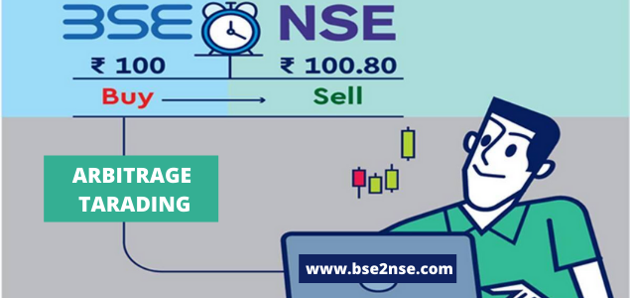
What is Arbitrage?
Arbitrage describes the act of buying a security in one market and simultaneously selling it in another market at a higher price, thereby enabling investors to profit from the temporary difference in cost per share.
Two exchanges present in India
1. NSE(National Stock Exchange)
2. BSE(Bombay Stock Exchange

Slide 3
need of arbitrage reccomendation sysyem ?
It captures changes in the market quickly and accurately and recommends the arbitrage opportunities
These occur only for short intervals and there are high chances of missing out on them if no prompt and informed decisions are made.

Slide 4

STRATEGY USED
Difference is calculated on the current prices of NSE and BSE.
Arbitrage=|NSEprice-BSEprice|

Slide 5
functionality
User login: username + password authentication.
Arbitrage opportunity recommendations based on current prices
User can save from recommended stocks.
Saved stocks are prevailed in the user's account.

Slide 6
system flow
LOGIN PAGE
ARBITRAGE RECCOEMNDAATIONS
SAVE STOCKS
Successful Login
Unsuccessful Login
ALERT TO RE-RNTER CREDENTIALS

Slide 7
Login page
User login AUTHENTICATION by username and password.
Successful login- Recommendations
Unsuccessful login- Re enter the credentials

Slide 8
arbitrage reccomedations (home page)

Slide 9
saved stocks

Slide 10



TECHNOLOGY STACK
Frontend : Angular
Backend : Spring boot
Database : MySQL

Slide 11
Adding a page to display all the stocks together
Enhancing compatibility for mobiles, desktop, tab browsers.
Graphical representation in historical analysis.
FUTURE SCOPE

Slide 12
thank you !

